Slide 1


Making Data Science Reproducible
Jesse Spencer-Smith, Ph.D.
Chief Data Scientist
Charreau Bell, Ph.D.
Senior Data Scientist

Slide 2
Foundations of Reproducible DS
Literate Programming (and best practices)
Versioning Code
Versioning Data
Versioning Models
“Versioning” Environments

Slide 3
Literate Programming
The idea is that you do not document programs (after the fact), but write documents that contain the programs.
—John Max Skaller

Slide 4
& Best Practices
Pipeline tests
R: assertr
Python: great-expectations
Mature code out of notebooks
Python: nbdev

Slide 5
Versioning Code
Use issues for project tracking
Use GitHub Project to gamify opening and closing issues
Close issues with commits where possible
Preface commits mentally with, “With this commit I…”

Slide 6
Versioning Data
Necessary for reproducibility and auditability
Critical/more challenging for Deep Learning
Your data IS your source code!
Many solutions
DVC – extension to git (also versions models)
Entire area under development

Slide 7
Versioning Models
Notes:
Let’s talk a bit about how versioning models can help with reproducibility
Is anyone willing to talk a little bit, maybe 15, 30 seconds or so, about the process they use to train their machine learning or deep learning models?
Hyperparameter tuning?
Comparison to other models?

Slide 8
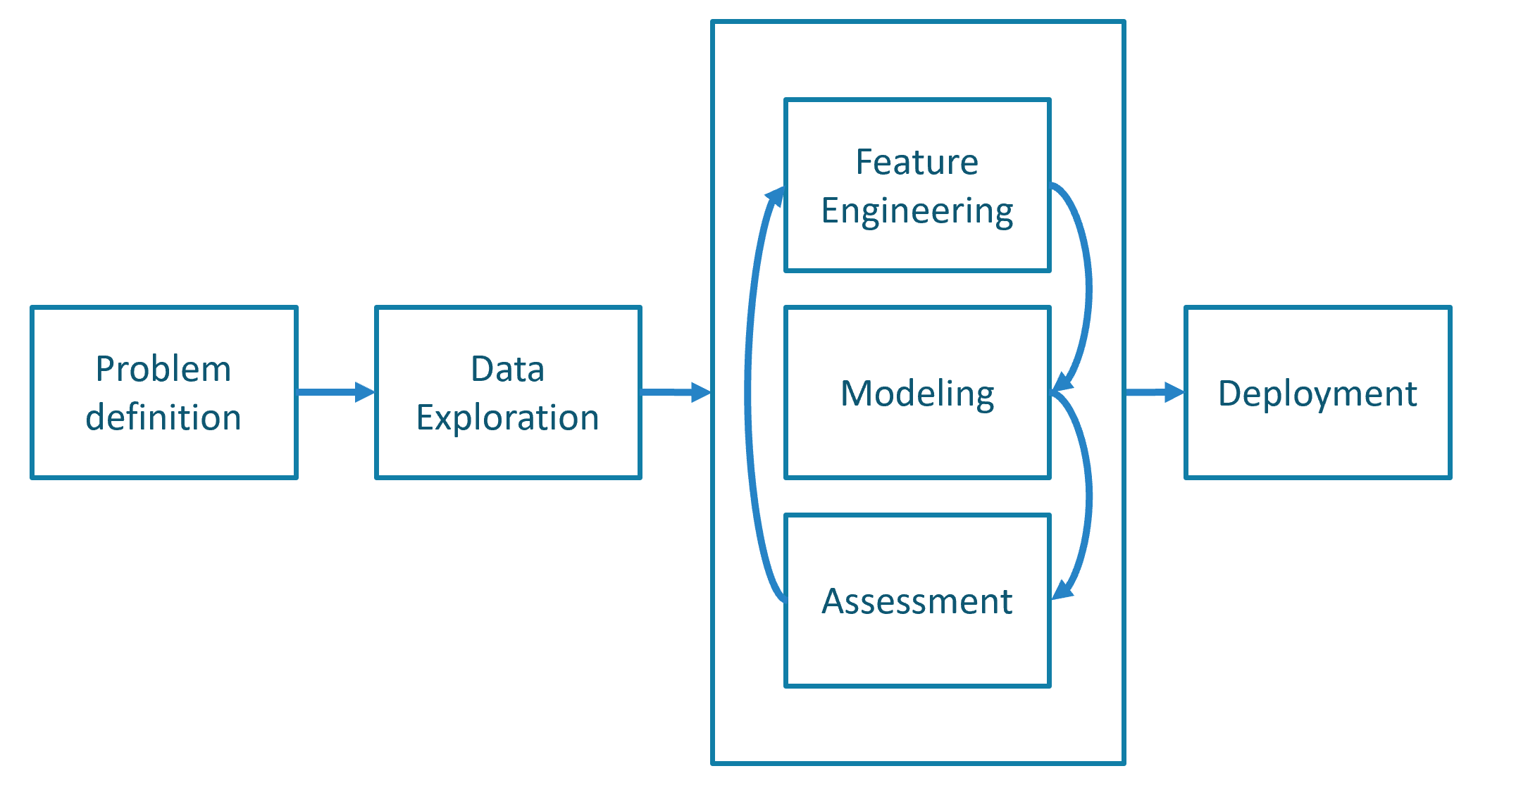
Data modeling is an iterative process
Notes:
I need the image about the iteration of the data science process here
- As you see here, the modeling steps can go through several iterations. Sometimes many iterations within the same iteration

Slide 9
Data modeling is an iterative process
Model A
Model A
Model A
Model A
History of model tuning efforts and performance
Comparison of models over time
Model reversion
Availability for collaboration
Hyperparameters
Hyperparameters
Performance Metrics
Hyperparameters
Performance Metrics
Model A
Performance Metrics
Hyperparameters
Model A
Model A
Performance Metrics
Hyperparameters
Model B
Hyperparameters
Performance Metrics
Hyperparameters
Performance Metrics
Performance Metrics
Model B
Model A
Model B
Hyperparameters
Hyperparameters
Hyperparameters
Hyperparameters
Performance Metrics
Performance Metrics
Performance Metrics
Performance Metrics
Model B
Model B
Model B
Model C
Hyperparameters
Hyperparameters
Performance Metrics
Hyperparameters
Performance Metrics
Performance Metrics
Model C
Model B
Model C
Hyperparameters
Hyperparameters
Hyperparameters
Hyperparameters
Performance Metrics
Performance Metrics
Performance Metrics
Performance Metrics
Notes:
Let’s walk through a set of scenarios that can lead to reproducibility issues
Let’s say we choose some model, Elastic Net, and decide to train a model. We might pick out one set of hyperparameters. But is it the best? Well, let’s do some hyperparameter tuning! What if we don’t write these down?
Now, we choose a completely different type of model and train it, also doing some hyperparameter tuning. How does this compare to our original? What if we wanted to look at their behavior over time with changing data?
What if we then trained a very expensive model with marginally better behavior? What if we then wanted to go back to a previous model?
Even more salient – what if we needed to share these models with others, testing the model on their data? The model needs to first be reproducible.

Slide 10
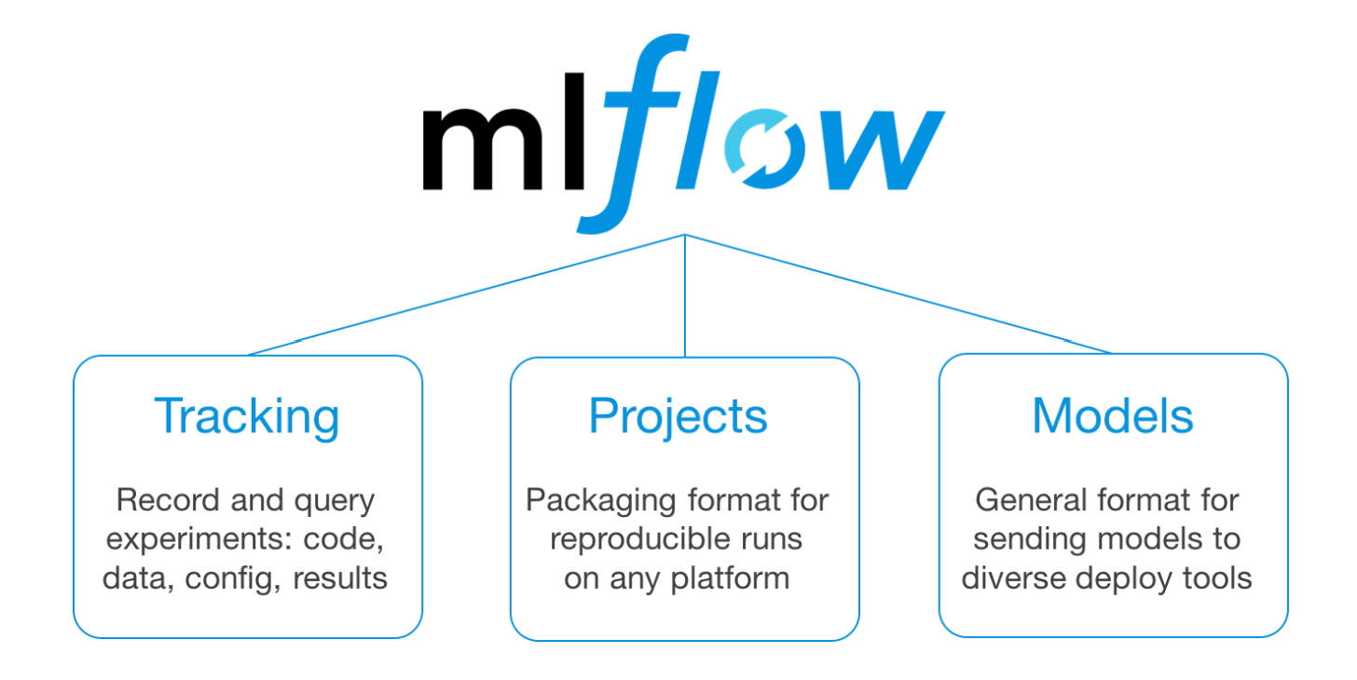
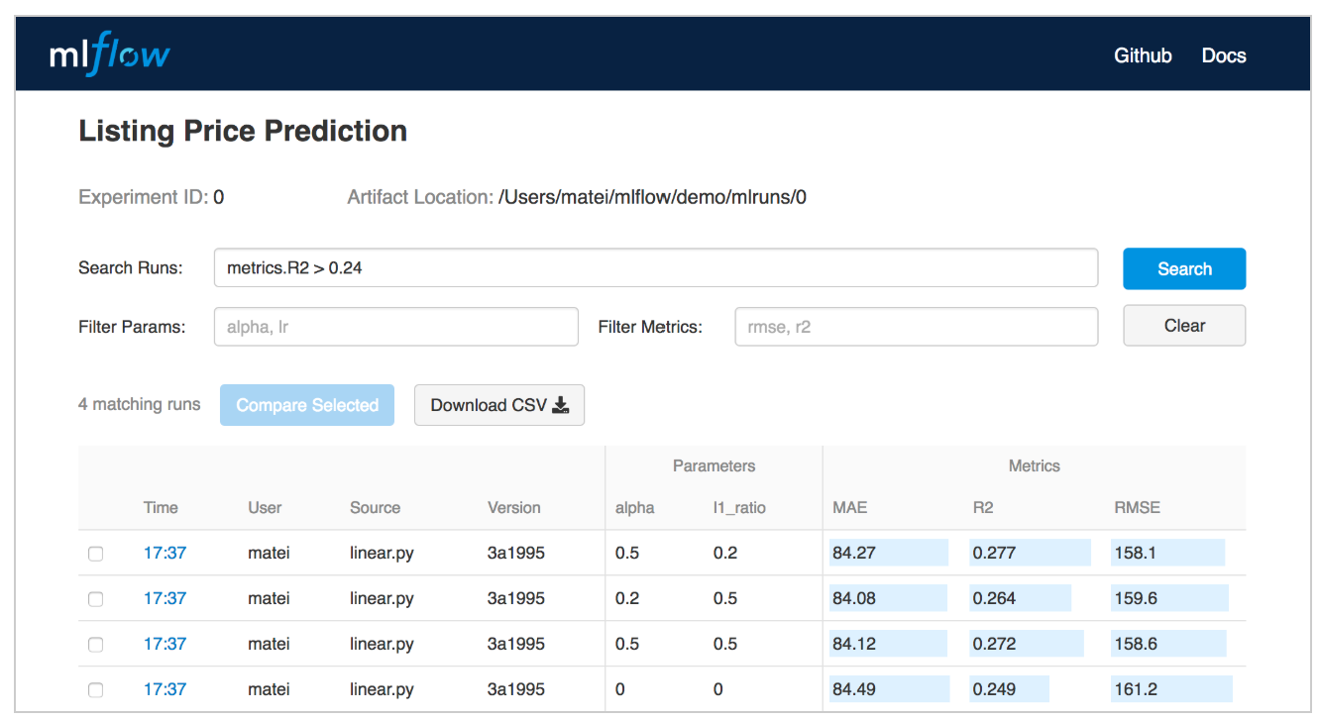
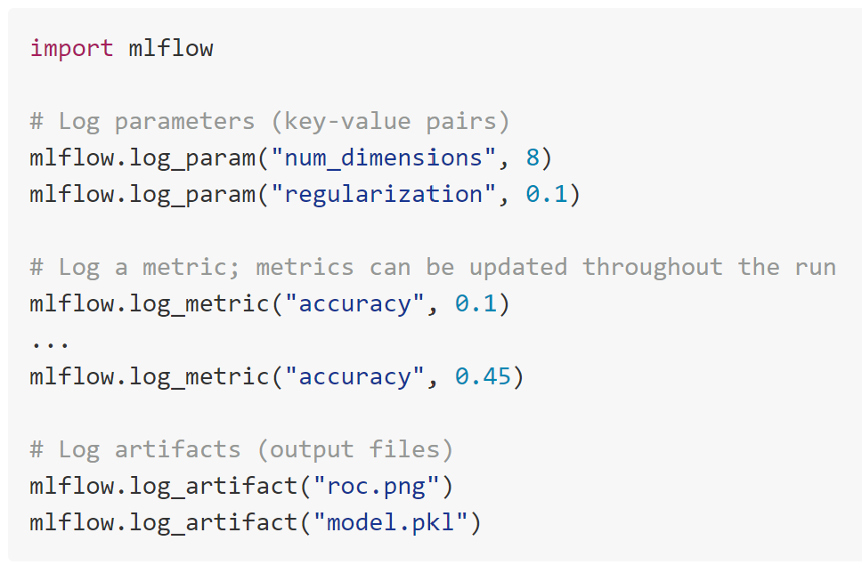
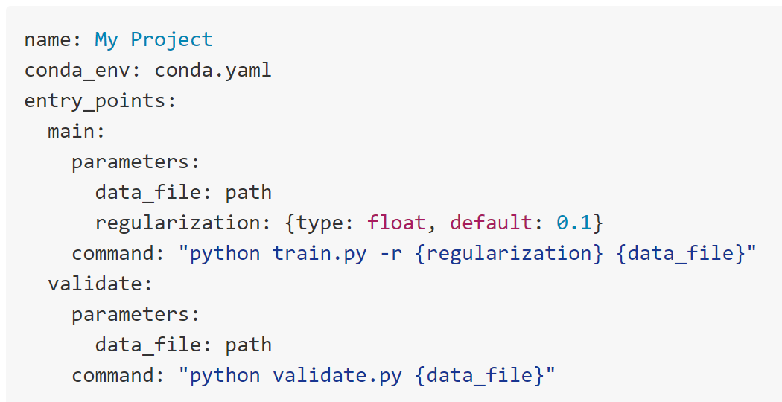
Model versioning: a solution
Michaelangelo
TFX
Others
Notes:
One such solution is MLFlow, although there are others.
MLFlow is open source and open!
Tracking. MLflow Tracking is an API and UI for logging parameters, code versions, metrics and output files when running your machine learning code to later visualize them. With a few simple lines of code, you can track parameters, metrics, and artifacts:
Projects. MLflow Projects provide a standard format for packaging reusable data science code. Each project is simply a directory with code or a Git repository, and uses a descriptor file to specify its dependencies and how to run the code. Links to a git commit hash
Models. MLflow Models is a convention for packaging machine learning models in multiple formats called “flavors”. MLflow offers a variety of tools to help you deploy different flavors of models. Deploy to Docker, Azure ML, SageMaker
Others: FBLearner Flow, TFX, Michaelangelo – missing “open source” and “open” part – MLFlow compatible with most frameworks

Slide 11
“Versioning” Environments

Slide 12

Environments: a challenge for reproducibility
Base
Installation: H2o
Project 1 – Base Defaults
Python = 3.7
Pandas = 0.25
fastai = 1.0.57
pytorch = 1.1.0
matplotlib = 3.1.1
cudatoolkit = 10.0.130
numpy = 1.16.4
x
Project 2 – Install new package
- Dependencies:
- cudatoolkit 9.0
- pytorch 1.0.1
Notes:
Let’s say you have a project – cancer project – computational biology – healthcare – law, and you’ve decided to use packages
It goes great, you submit to a journal
Now, you start on another project. However, this project requires some different dependencies. By default, this isn’t going to work, so conda is going to try to replace your packages with the desired version

Slide 13
Environments: a challenge for reproducibility
Base
Installation: H2o
Project 1 – Base Defaults
Python = 3.7
Pandas = 0.25
fastai = 1.0.57
pytorch = 1.1.0
matplotlib = 3.1.1
cudatoolkit = 10.0.130
numpy = 1.16.4
testpackage = 1.0.2
x
Project 2 – Install new package
- Dependencies:
- cudatoolkit 9.0
- pytorch 1.0.1
1.0.1
9.0.148
Notes:
Install your new packages, roll back your code versions, and now it’s working awesomely. Fantastic – project 2 is underway.

Slide 14
Environments: a challenge for reproducibility
Base
Installation: H2o
x
Project 1 – Base Defaults
Python = 3.7
Pandas = 0.25
fastai = 1.0.57
pytorch = 1.1.0
matplotlib = 3.1.1
cudatoolkit = 10.0.130
numpy = 1.16.4
testpackage = 1.0.2
Project 2 – Install new package
- Dependencies:
- cudatoolkit 9.0
- pytorch 1.0.1
1.0.1
9.0.148
Notes:
Now, we’ve installed the packages and they’re working great. The project is underway.
During this time, you get back your reviews for the first project, asking for a few more “experiments” or assessments on the results
You open your project, and now try to run your code [aah]
(Unlikely) it runs as normal
It doesn’t run at all because the code is broken
It has completely different performance, either better or worse. Regardless, you now have to figure it out AND explain it

Slide 15
Virtual environments – a solution
project1-env
testpackage-env
Installation: H2o
Python = 3.7
Pandas = 0.25
fastai = 1.0.57
pytorch = 1.1.0
matplotlib = 3.1.1
cudatoolkit = 10.0.130
numpy = 1.16.4
Python = 3.7
Pandas = 0.25
fastai = 1.0.57
pytorch = 1.0.1
matplotlib = 3.1.1
cudatoolkit = 9.0.148
numpy = 1.16.4
testpackage = 1.0.2
Project 1 Environment Settings
Project 2 Environment Settings

Slide 16
Virtual environments – a (partial) solution
project1-env
testpackage-env
Installation: H2o
Python = 3.7
Pandas = 0.25
fastai = 1.0.57
pytorch = 1.1.0
matplotlib = 3.1.1
cudatoolkit = 10.0.130
numpy = 1.16.4
Python = 3.7
Pandas = 0.25
fastai = 1.0.57
pytorch = 1.0.1
matplotlib = 3.1.1
cudatoolkit = 9.0.148
numpy = 1.16.4
testpackage = 1.0.2
Project 1 Environment Settings
Project 2 Environment Settings
Notes:
This is only really a partial solution, and it has two real flaws.
This works fantastically and locally so long as you remember the names of your environment. Two, three months down the road, you have no idea what you called your environment.
Before, we learned about GitHub repositories. Instead of using it just on your own, you want to share with a collaborator or the general community to try your work. You post it on GitHub, but (1) people can’t run it at all, or (2) again, they get different results
Why? A potential reason might be that they don’t even have the same code and package environment as you. So how can you share your code environment?

Slide 17
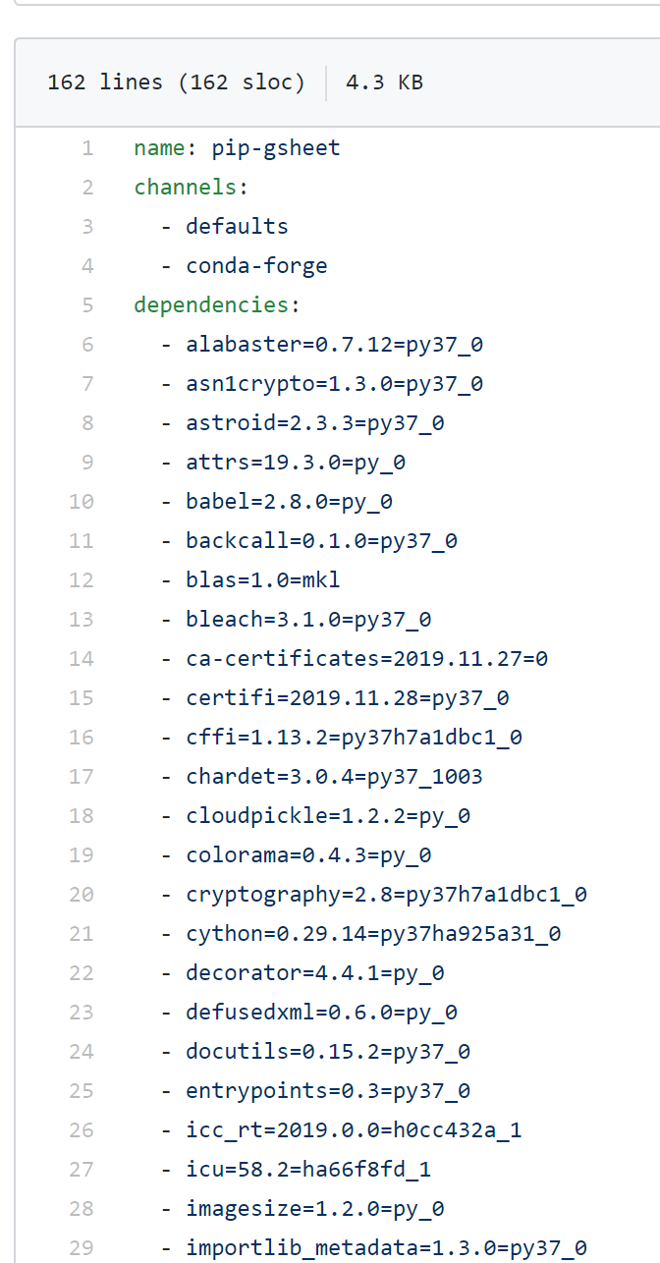
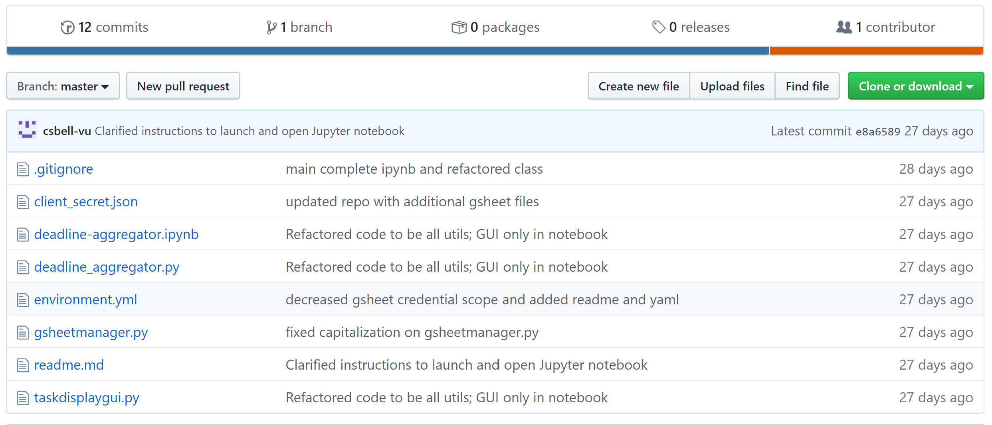
Yml files – a solution
Create virtual environments directly from yml
yml file also versioned in GitHub
Use other services (Binder) to run your project

Slide 18
What are your favorite tools for reproducible research?
Notes:
I need the image about the iteration of the data science process here
- As you see here, the modeling steps can go through several iterations. Sometimes many iterations within the same iteration

Slide 19
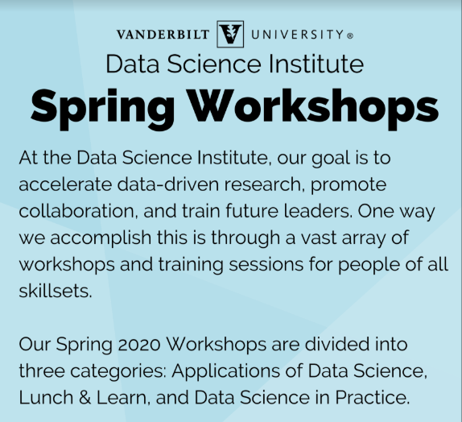
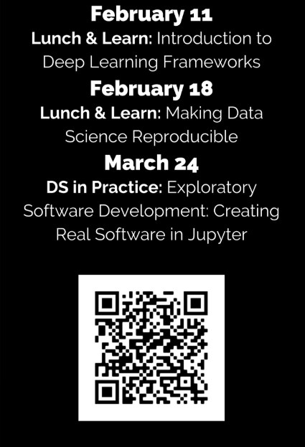
Visit https://www.vanderbilt.edu/datascience/events/data-science-workshops/

Slide 20
NLP Learning Cohort
A Code-First Introduction to Natural Language Processing fast.ai Rachel Thomas
Topics: topic modeling, classification, language modeling, and translation
Approaches:
traditional NLP (including regex, SVD, naive bayes, tokenization) and
neural network (including RNNs, seq2seq, attention, and the transformer architecture)
Email Jesse.Spencer-Smith@Vanderbilt to be added to the Slack organizing channel.

Slide 21

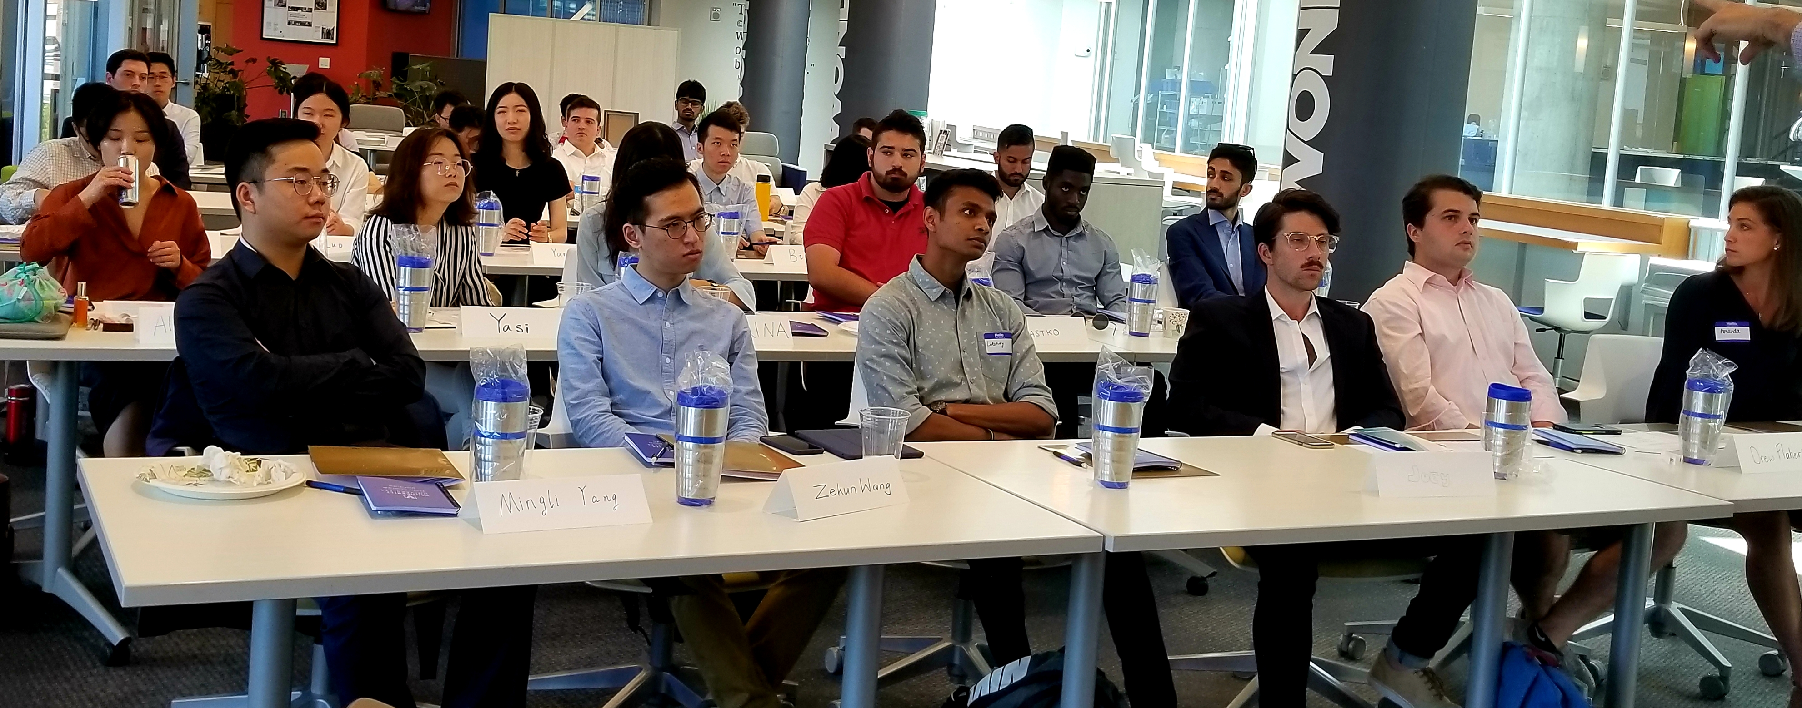
Professional M.S. Program
If you are interested in having summer interns or advising MS capstone projects, come talk to us!

Slide 22

Consulting and research engagements with data science team

Slide 23
www.vanderbilt.edu/datascience/

Slide 24

Repository
https://github.com/vanderbilt-data-science/reproducible-ds

